Slide 1
Java EE: Programming Servlets
Introduction

Slide 2
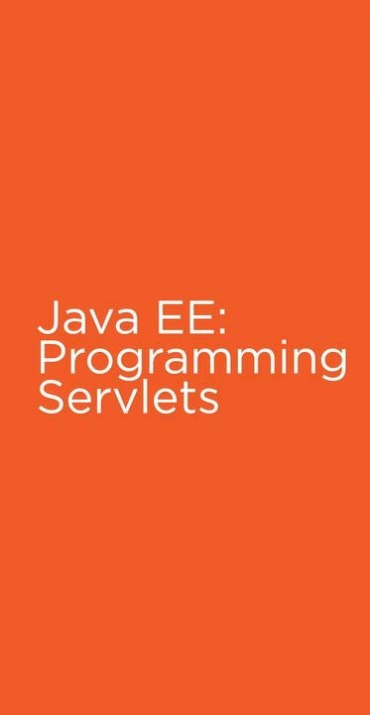
Introduction
Building and Deploying your First Servlets
Working with Form and Query String Data
Handling HTTP Requests and Responses
Intercepting HTTP Requests with Filters
Handling Exceptions in Servlets
Tracking Session Data
Packaging Servlets for Deployments
Providing Servlets Metadata using Annotations

Slide 3
Core Java Fundamentals
Prerequisite
JDBC
HTML

Slide 4

How Web Technology and CGI works? What is Servlets?
Architecture Of Servlets Servlets Life Cycle
Setting up Tomcat Web Server

Slide 5
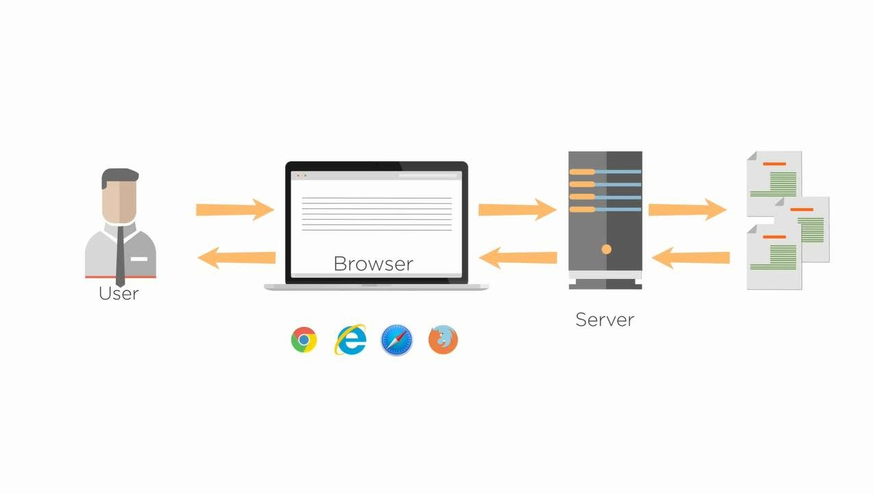

Slide 6
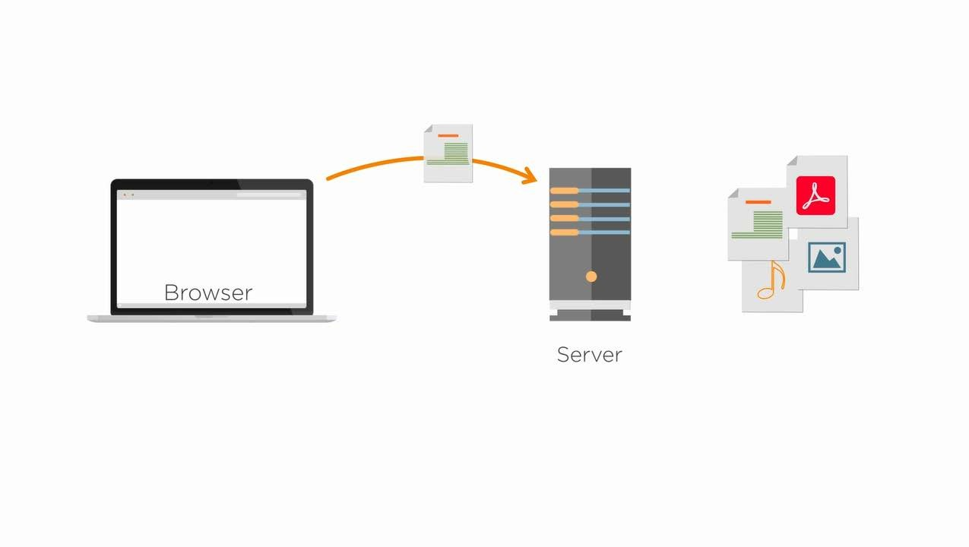

Slide 7
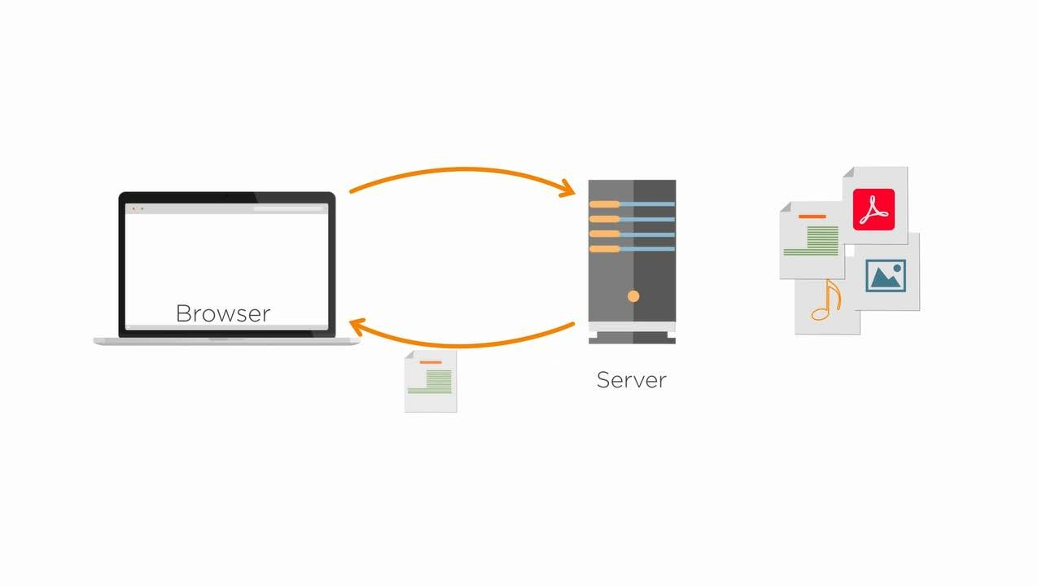

Slide 8
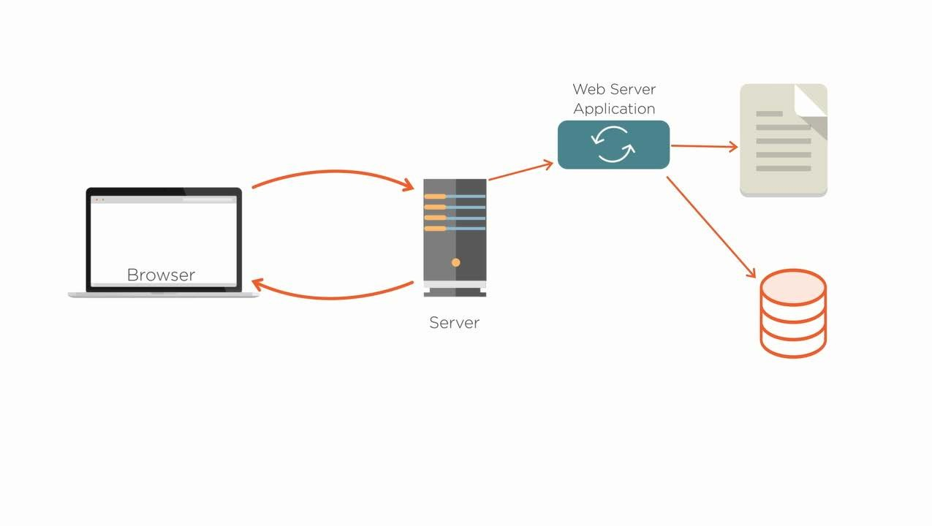

Slide 9
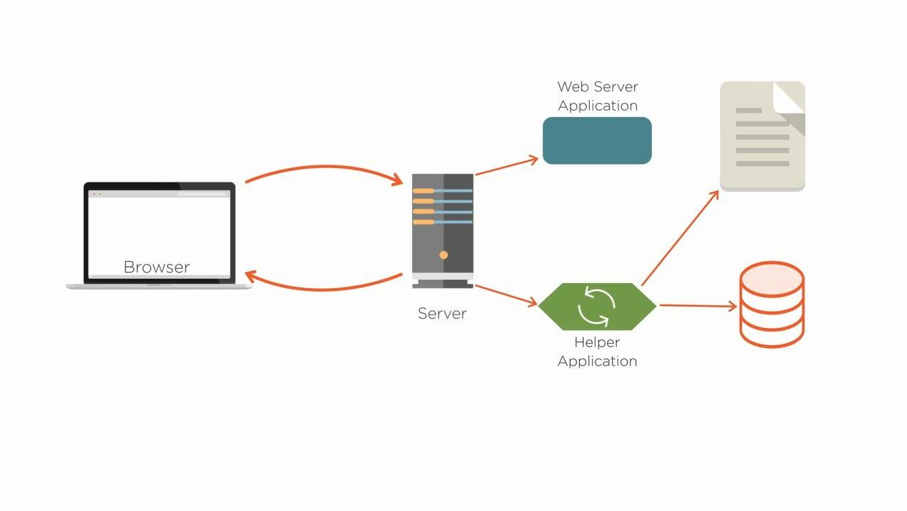

Slide 10


Slide 11
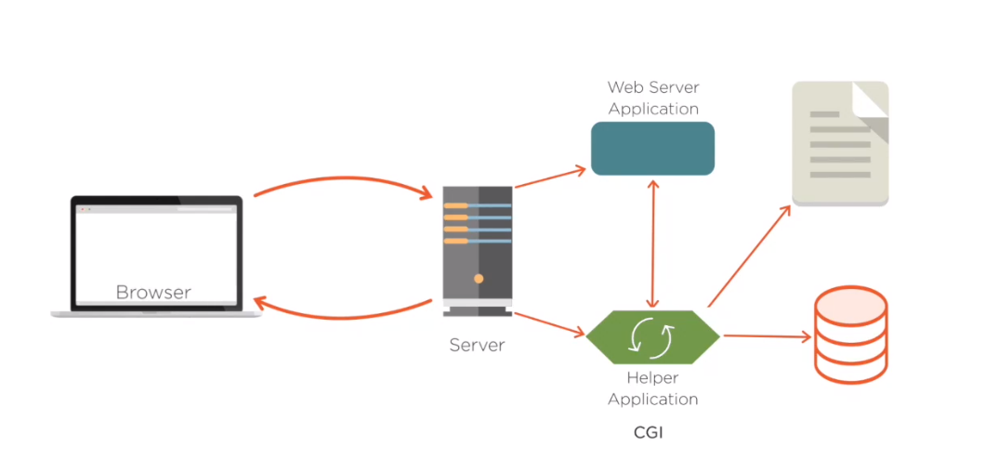

Slide 12
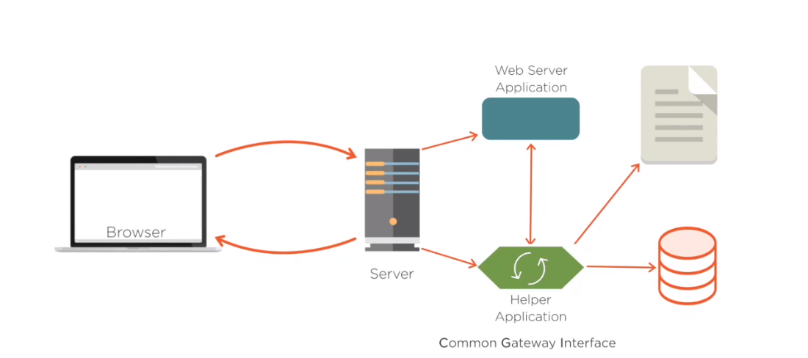

Slide 13
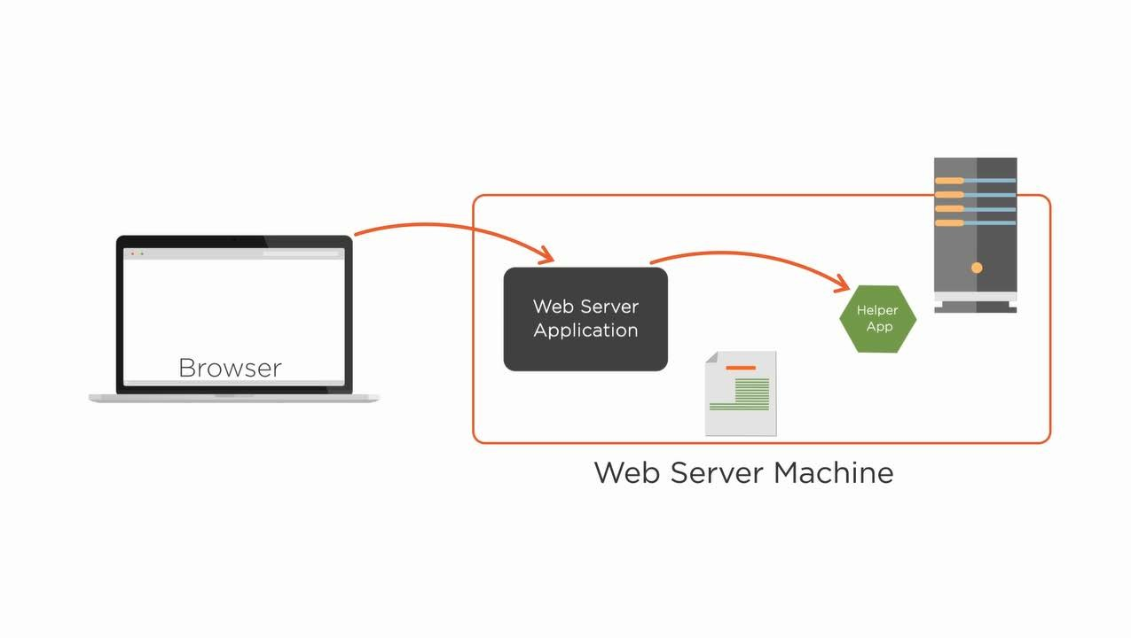

Slide 14
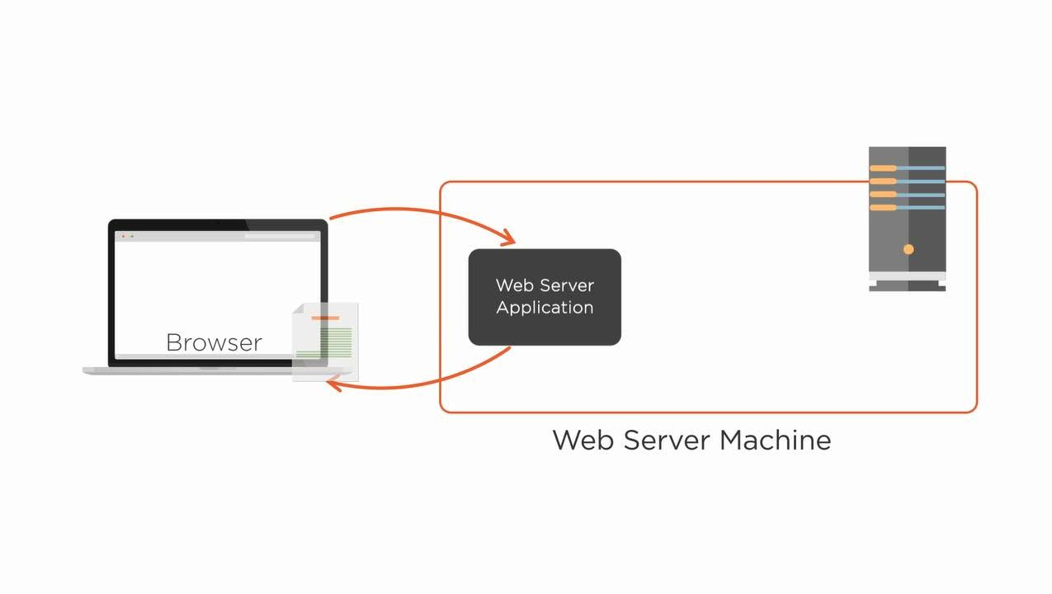

Slide 15
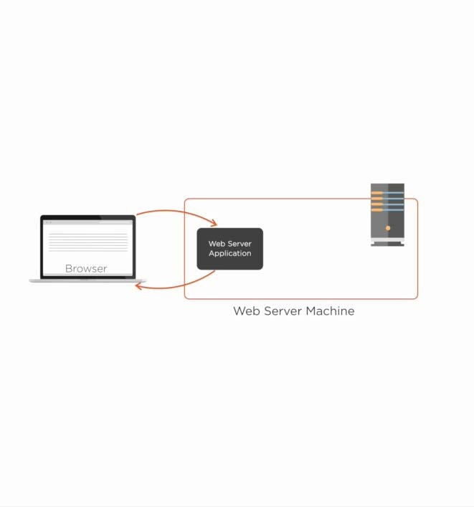
Limitations
Performance will be slow
New Database connection must be established for every request
Solution
Java Servlets

Slide 16
Architecture of Servlets

Slide 17
What is Servlet?
Servlet is a Java programming language class that is used to extend the capabilities of servers that host applications accessed by means of a request-response programming model.

Slide 18




Advantages of Servlets
Performance Performance is significantly better
Platform Independent
Servlets are
Platform Independent
Library
Trusted
Servlets are trusted _{Full functionality}
of the Java class library is available

Slide 19
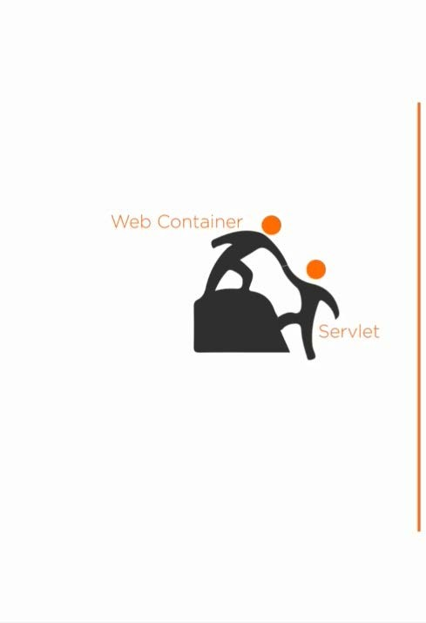
Instantiate the Servlet
Get the Request and the Response Manage
-Life
-Death
-Resources of the Servlet Supported Web Containers
Tomcat,Jetty,JWS and Resin

Slide 20
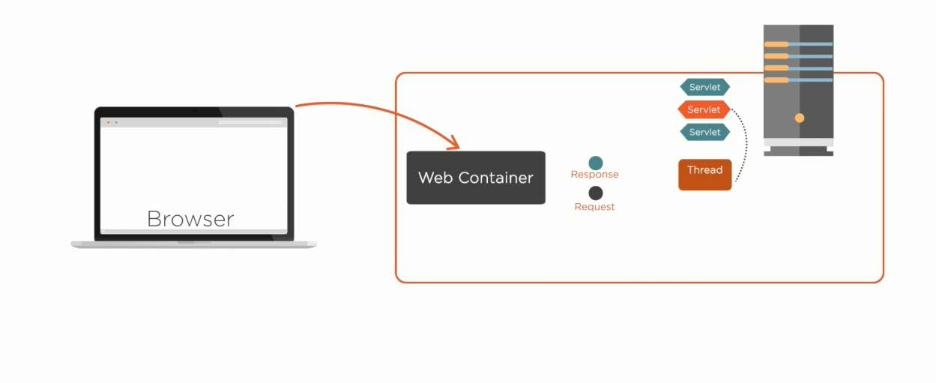
Architecture of Servlets

Slide 21
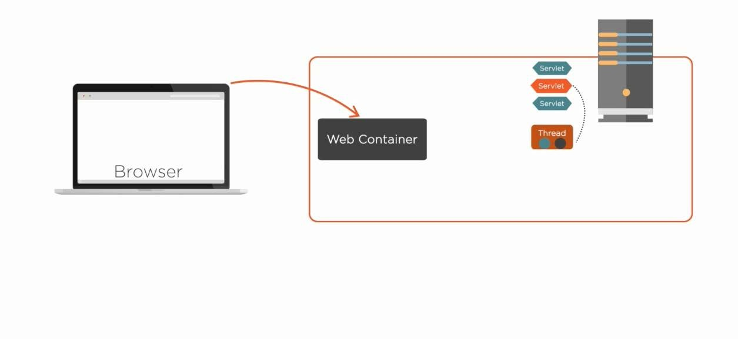
Architecture of Servlets

Slide 22
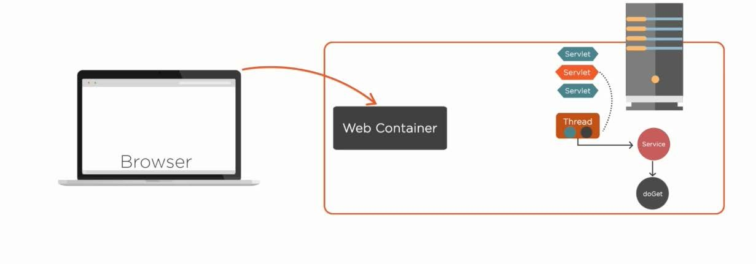
Architecture of Servlets

Slide 23
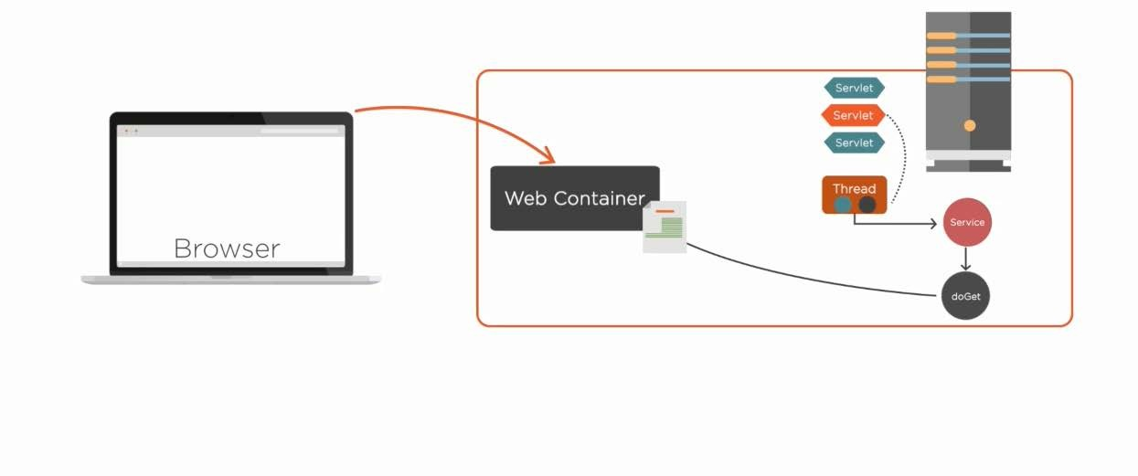
Architecture of Servlets

Slide 24
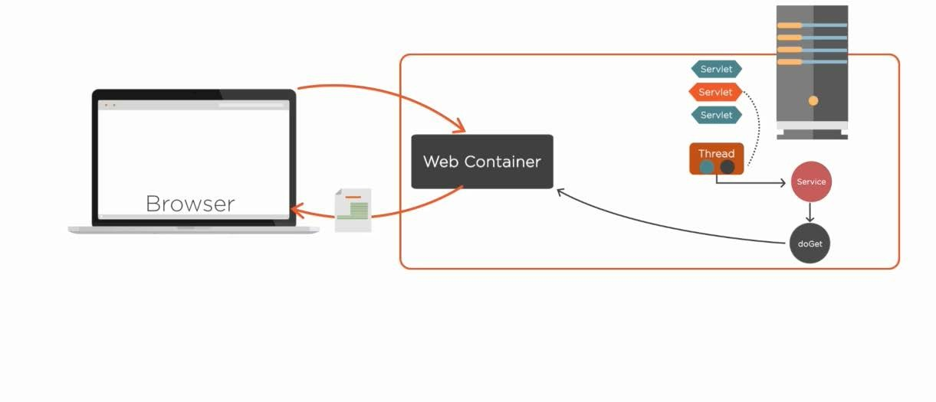
Architecture of Servlets

Slide 25
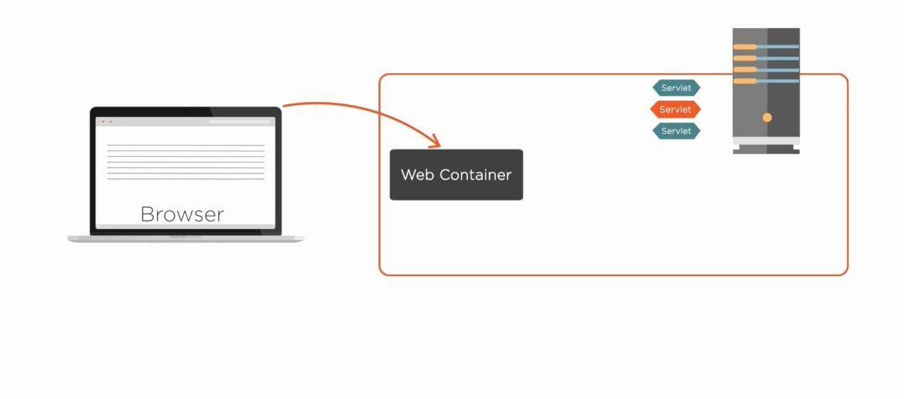
Architecture of Servlets

Slide 26
Servlets Life Cycle

Slide 27
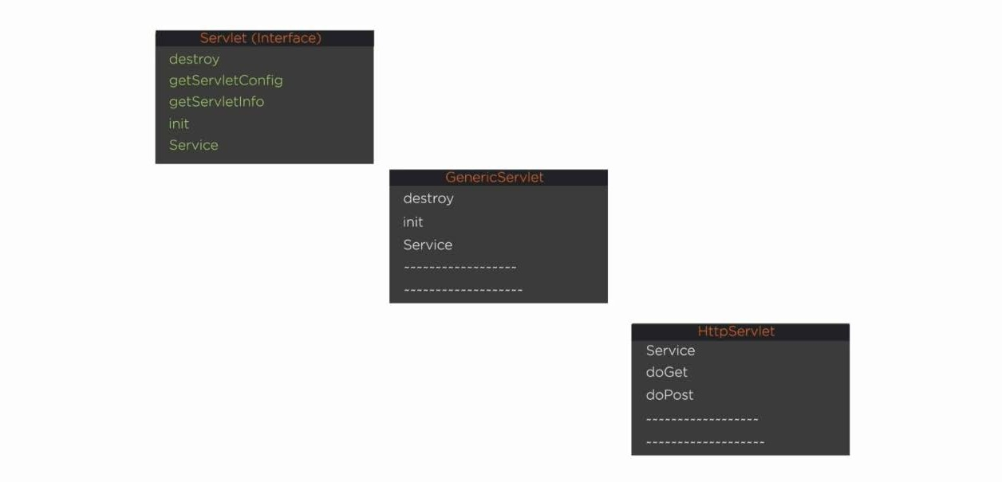
Servlets Class Hierarchy

Slide 28
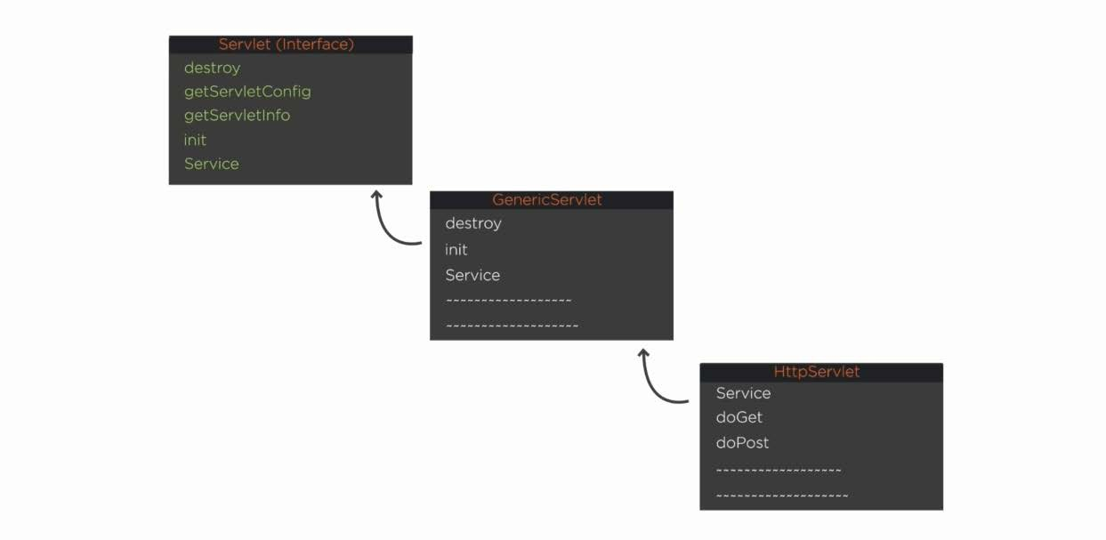
Servlets Class Hierarchy

Slide 29
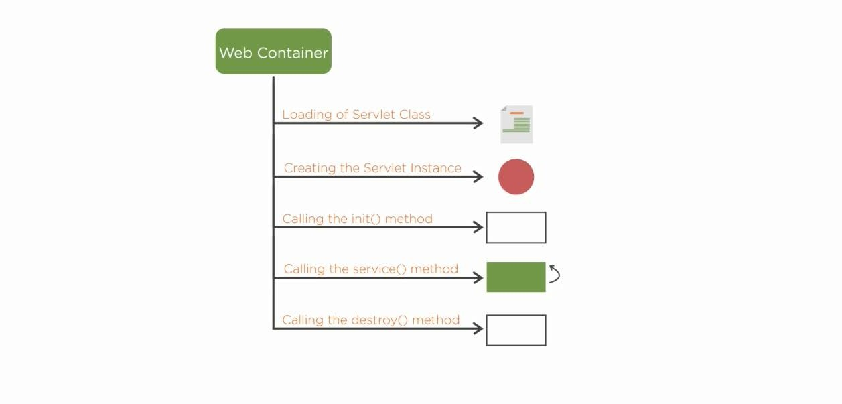
Servlets Life Cycle

Slide 30
Setting Up Tomcat Web Server

Slide 31

Architecture Of Servlets Servlets Life Cycle
Setting Up Tomcat Web Server

